Slide 1
Basic Programming
Starting with C++

Slide 2
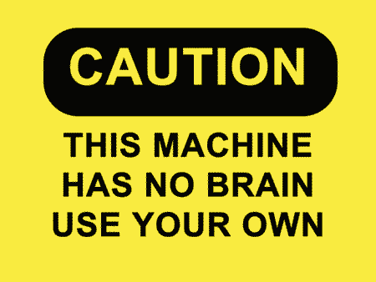
Selling your idea
What is programming?
Programming is the process of taking an algorithm and encoding it into a notation, a programming language, so that it can be executed by a computer. Your computer is a dumb machine, you need to explain every single thing to it. In order to give him instruction, you need a language to communicate
What is programming language?
A programming language is a formal language which comprises a set of instructions used to produce various kinds of output. Programming languages are used to create programs that implement specific algorithms.

Slide 3


List of Programing languages
C/C++
Java
Javascript
Python
Ruby/Rails
R

Slide 4
Enough of talks, where to code?
IDE VS CODE EDITORS
IDE-An integrated development environment (IDE) is a software suite that
consolidates the basic tools developers need to write and test software. Typically,
an IDE contains a code editor, a compiler or interpreter and a debugger that the
developer accesses through a single graphical user interface (GUI).
A source code editor is a text editor program designed specifically for editing
source code of computer programs. It may be a standalone application or it may
be built into an integrated development environment (IDE) or web browser.
Source code editors are a fundamental programming tool, as the fundamental job of programmers is to
write and edit source code.
Tip
There are many IDEs available, like Code blocks, CLion, online editors like CS50 IDE (aka cloud 9), hackerearth.

Slide 5
Some more basics please
Compiler: A compiler is a special program that processes statements written in a
particular programming language and turns them into machine language or
"code" that a computer's processor uses.
Debugger:A debugger is a software program used to test and find bugs (errors)
in other programs.

Slide 6
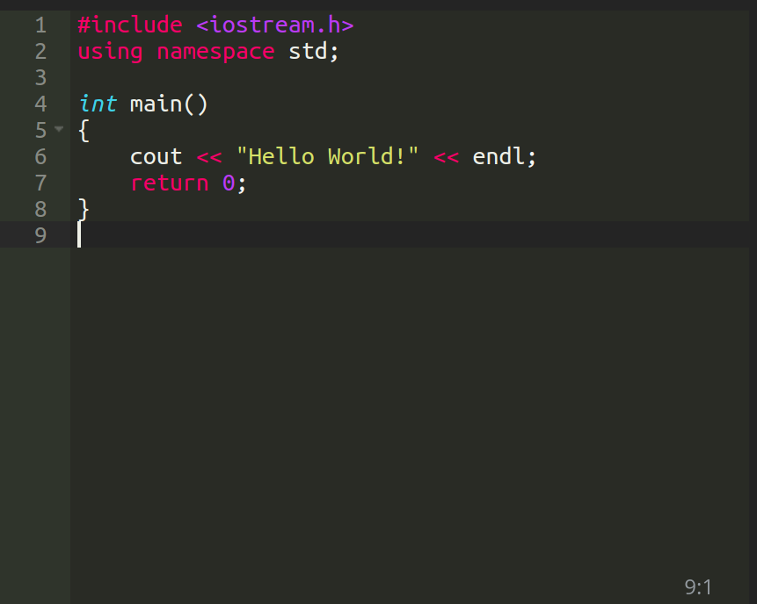
Printing Hello world!

Slide 7
What are header files?
As programs grow larger and larger (and include more files), it becomes
increasingly tedious to have to forward declare every function you want to
use that lives in a different file. Wouldn’t it be nice if you could put all your
declarations in one place? C++ code files (with a .cpp extension) are not the
only files commonly seen in C++ programs. The other type of file is called a
header file, sometimes known as an include file.
Header files usually have a .h extension, but you will sometimes see them with
a .hpp extension or no extension at all. The purpose of a header file is to hold
declarations for other files to use.
List of some header files
iostream.h
stdio.h
stdlib.h
conio.h
math.h
….
...

Slide 8
cin, cout
The cin and cout statements are known as console input and console output respectively. They take input and output from the console that is your keyboard

Slide 9
The main( ) function
The main() function doesn’t really have to do anything other than be present inside your C source code. Eventually, it contains instructions that tell the computer to carry out whatever task your program is designed to do. But it’s not officially required to do anything.

Slide 10
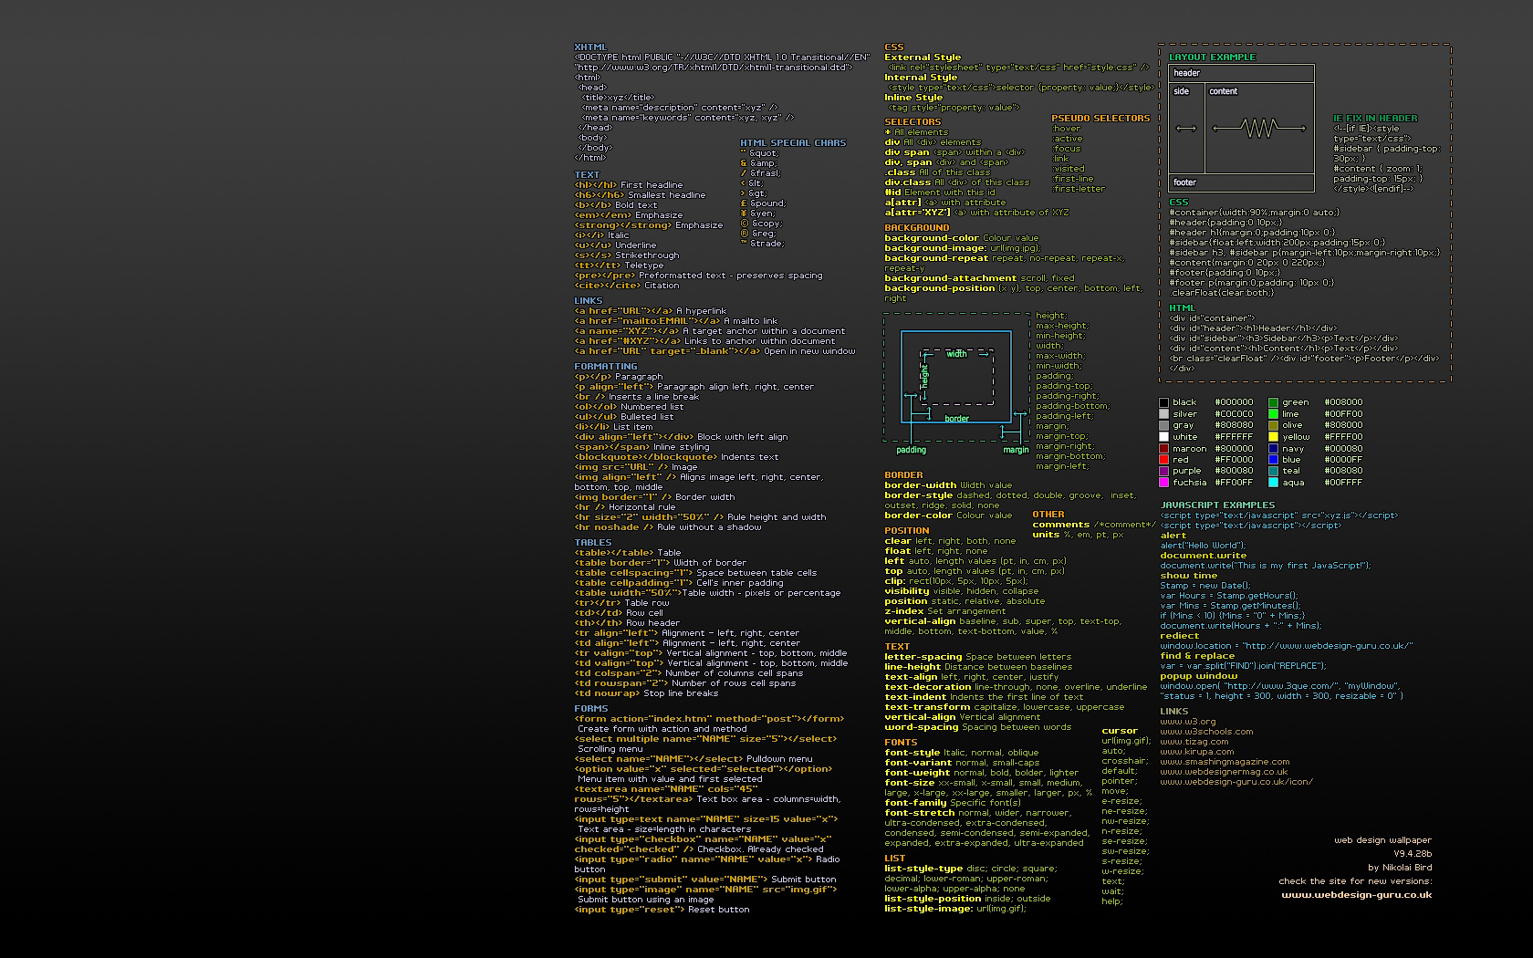
DATA TYPES & VARIABLE
Int
Float
Char
Double
Variable:- A variable provides us with named storage that our programs can manipulate.
5
Int
X
x
X

Slide 11
Operators
Assignment Operators
And Operator(&&)
Or Operator( || )
Not Operator( != )
Bool Operator(==)
Increment & Decrement Operators(a++ , ++a , a-- , --a)

Slide 12
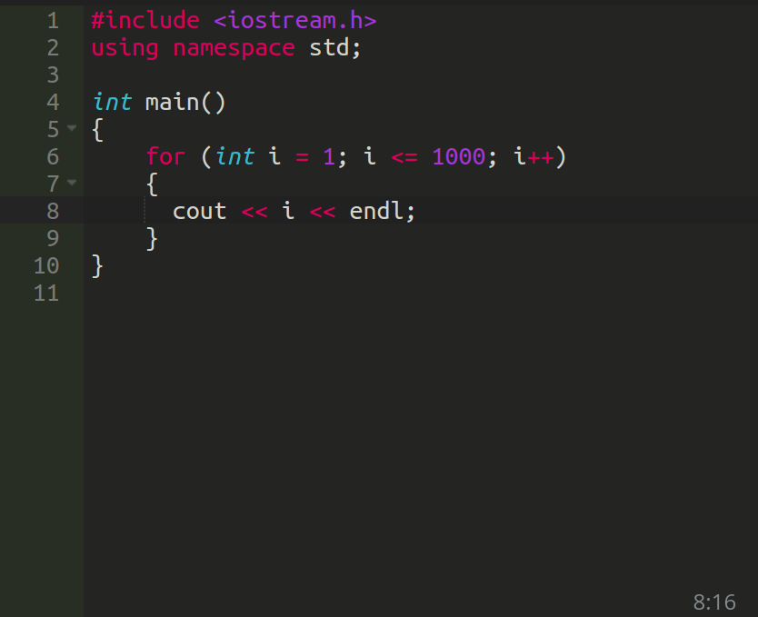
Loops in programming are used when we
need to repeatedly execute a block of statements.
For example:
Suppose we want to print nos. from 1 to 1000.
Should we write it 1000 times? No NEVER!
We use loops for these execution
Loops in C++

Slide 13
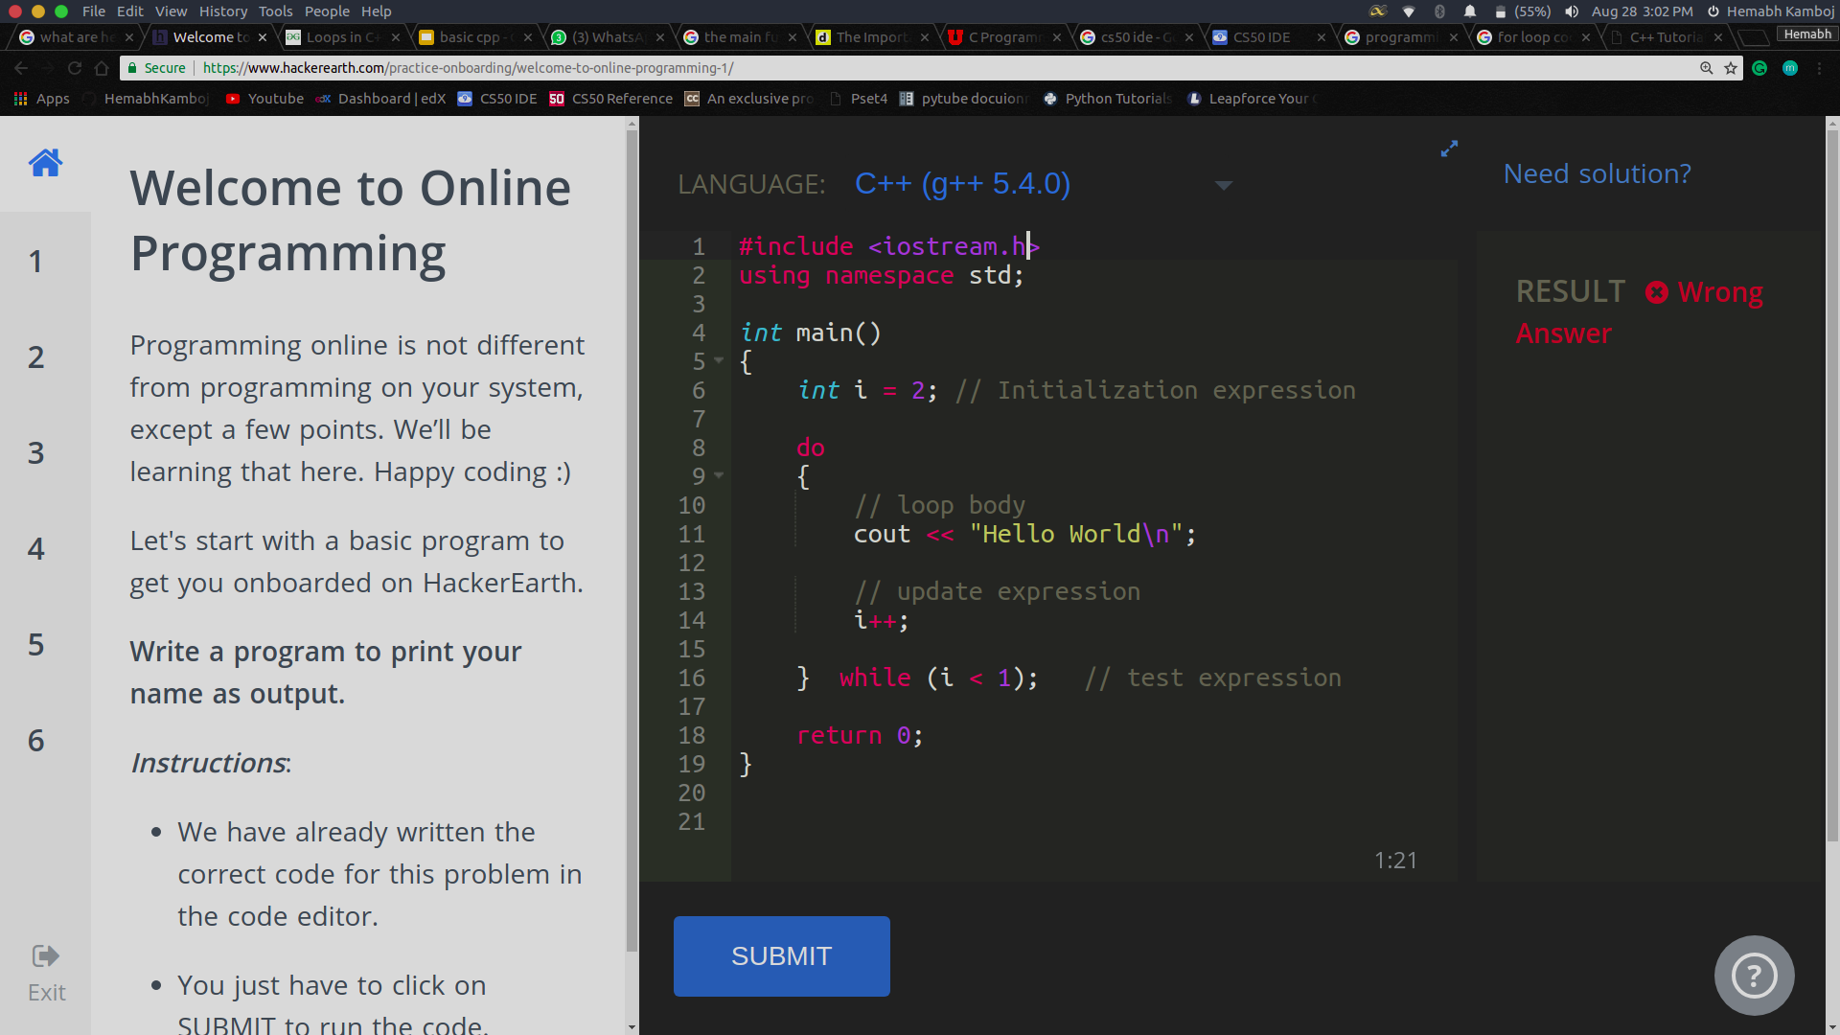
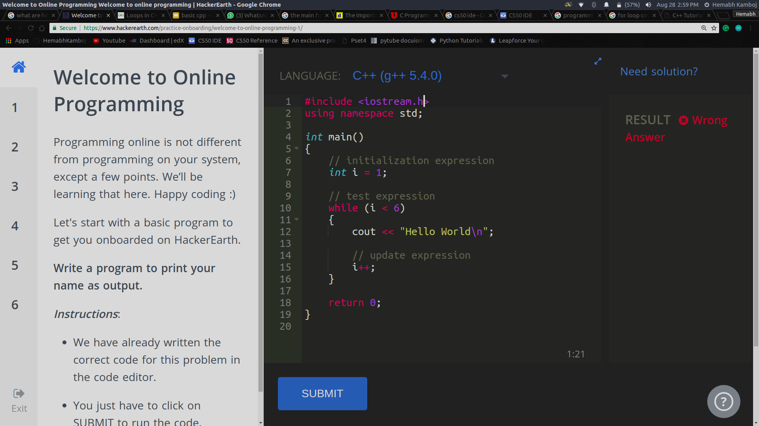
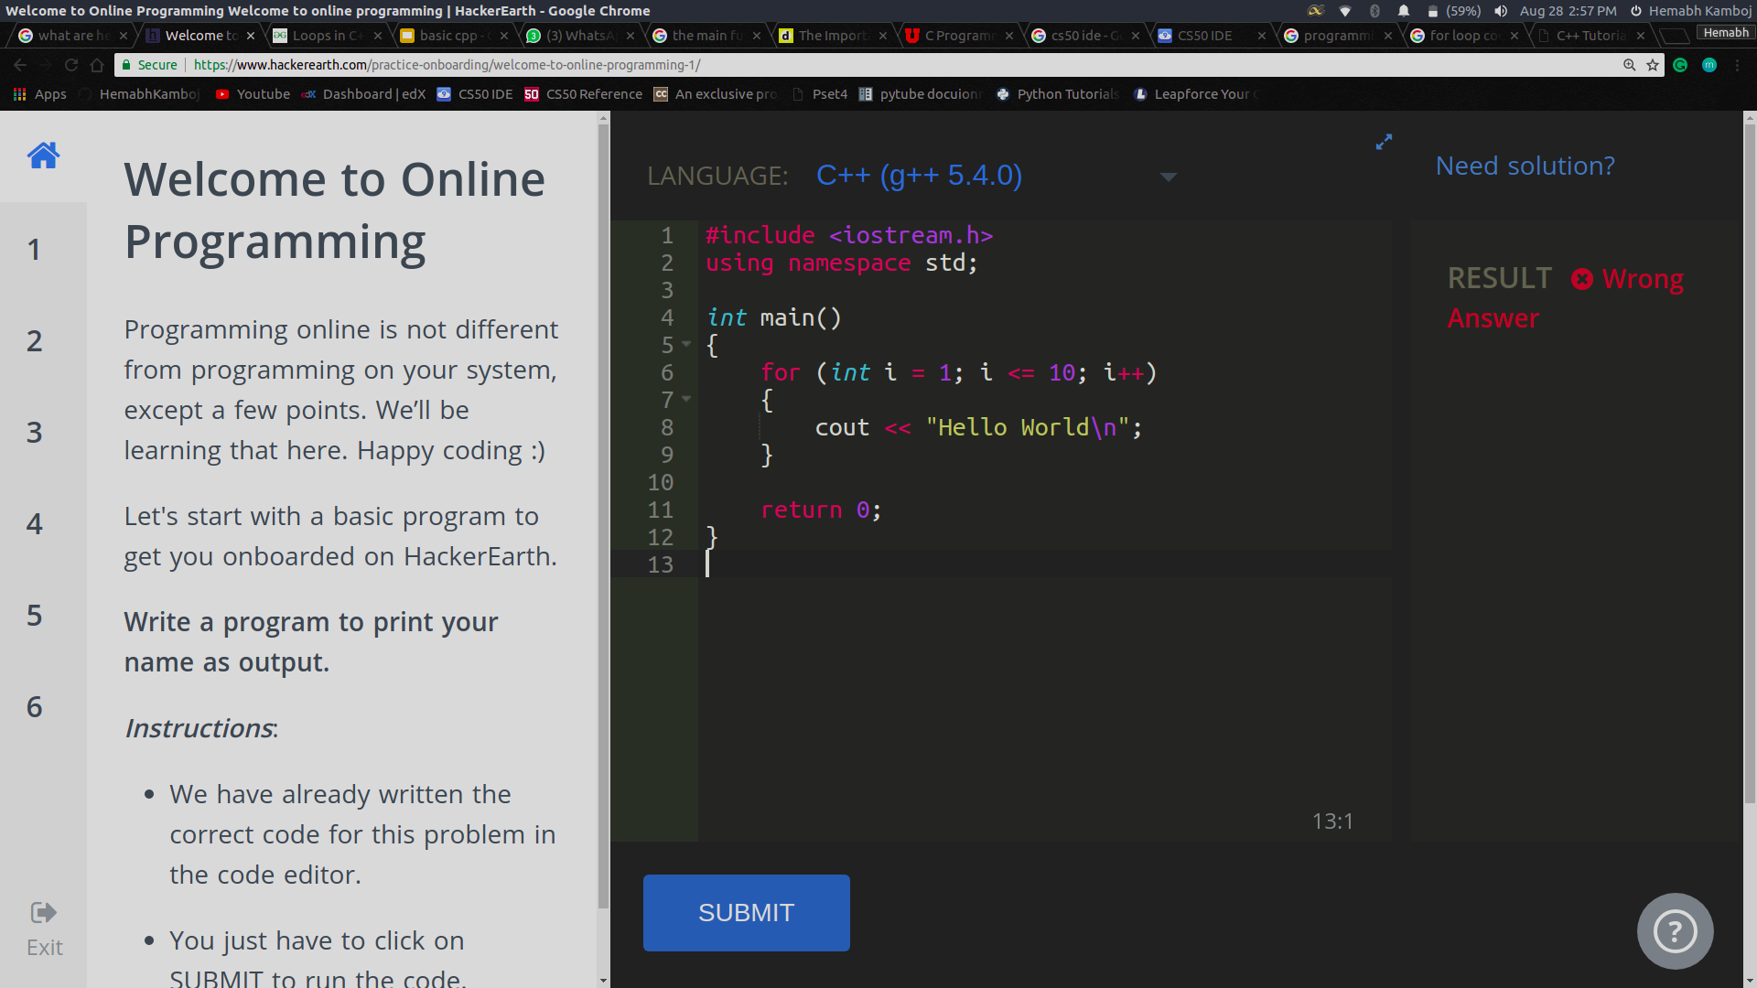
Types of Loops
do while
initialization expression; do { // statements update_expression; } while (test_expression);
for loop
for (initialization expr; test expr; update expr) { // body of the loop // statements we want to execute }
while loop
initialization expression; while (test_expression) { // statements update_expression; }

Slide 14
THANK YOU!
Join IEEE CS DTU:
Riddhima: 98997 87404
Drishti: 70421 43288
Umang: 72908 44519
Samarth: 95821 84794
Vibhor: 98106 60617
IEEE CS DTU
Delhi Technological University

